Slide 1
AGENDA
Express Js Introduction
Creating a http server
Event Loop and callbacks
Routing and Controllers
Middlewares

Slide 2
EXPRESS JS
Fast, unopinionated, minimalist web framework for NodeJs
“npm install express –save”
Can be used to write REST API
And MVC Applications

Slide 3
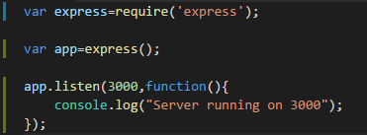
HTTP SERVER

Slide 4
EVENT LOOP
Node is a single threaded system
Uses event loop to handle multiple requests
http req 1
Event Loop
query
database
http req 2
http res 1
result
http res 2

Slide 5
CALLBACK
Function which will be called in future
Anonymous function
Called end of an asynchronous operation

Slide 6
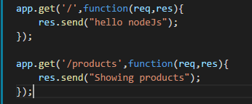
ROUTING

Slide 7

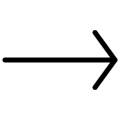

MIDDLEWARE
Middleware is a function that is invoked by the Express.js routing layer before the request handler
There can be any number of middleware registered.
Middleware has three parameters req,res and next
Web app
middleware
Request handler
Error response

Slide 8
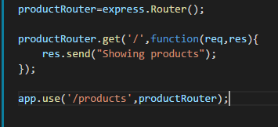
ROUTERS

Slide 9
SUMMARY
Express Js Introduction
Creating a http server
Event loops and callback
Routing and Controllers
Middlewares

